Slide 1
Engineering and IT Management Professional Practice course (2911)
Claude D’Amours, B.A.Sc., M.A.Sc., Ph.D., P.Eng

Slide 2
Agenda
Management vs Project Management
Project Management at a glance
Requirements Management
Time Management
Cost Management
Risk Mangement

Slide 3
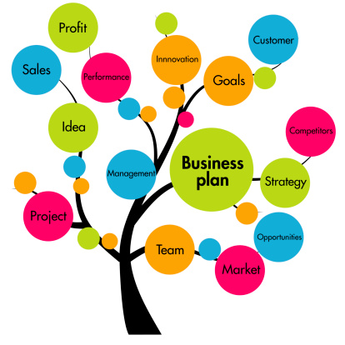
MANAGEMENT VS PROJECT MANAGEMENT

Slide 4
Definitions
Management is an ongoing organizational function that performs activities to produce products or supply services.
Furthermore, operations are permanent endeavors that produce repetitive outputs. Resources are assigned to do the same tasks according to operating procedures and policy.
A project is temporary in that it has a defined beginning and end in time, and therefore defined scope and resources.
Project management, then, is the application of knowledge, skills, tools, and techniques to project activities to meet the project requirements.
Management
Project
Project Management
Sources:
Leadershipthoughts.com
PMI.com
Notes:
From Leadership Thoughts .com
Operations Management is an ongoing organisational function that performs activities to produce products or supply services. For instance, production operations, manufacturing, IT service management, and accounting operations. Furthermore, operations are permanent endeavours that produce repetitive outputs. Resources are assigned to do the same tasks according to operating procedures and policy.
Project Management
In contrast, projects are temporary and help the business to meet organisational goals and to respond quickly and easily to the external environment. Organisations use projects to change operations, products and services to meet business need, gain competitive advantage and respond to new markets.
Also related are Program Management and Product Management. Both apply the methods and concepts of project management within a larger context.
Program Management
For very large endeavors (a program), the work is often decomposed into a number of projects. Each project may be executed by a different part of the organization or by different organizations. The Apollo program to land a man on the moon is an example. There were multiple launches (Apollo 1, 2, ...), each was a sub-program that split into projects and divided amongst subcontractors.
Product Management
The management of the evolution of a product, from conception to retirement, is known as Product Management. Each release of the product is managed as a separate project, but the overall evolution of the product is considered during planning. A backlog of defects and enhancements to be made is maintained and prioritized for implementation by the product manager. Each release implements a subset of the backlog within the context of a project.

Slide 5

PROJECT MANAGEMENT AT A GLANCE
Notes:
DO YOU SEE THE BEGINNING AND THE END ?
WITHOUT MANAGEMENT THIS IS WHAT WORK CAN LOOK LIKE!

Slide 6
If you fail to plan, … you are planning to fail !
- Benjamin Franklin

Slide 7
Project Management = Common Sense
Plan
Build a good team
Complete your tasks on time
Prioritize
Plan for the unexpected
Keep the overall plan in mind
Monitor and manage change

Slide 8
Professionals in Project Management
The COMPLEX NATURE of design requires a methodology to ensure all the pieces fall in the right place.
Open problems
Complexity
Limited time
Limited resources

Slide 9
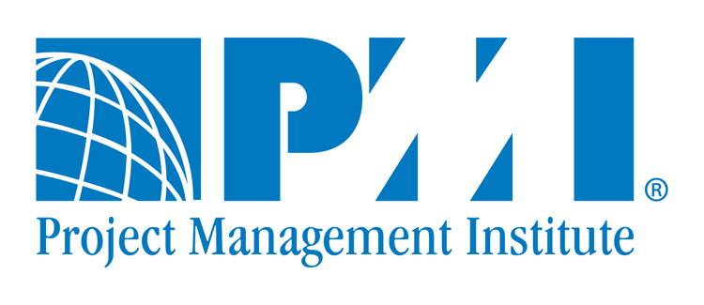
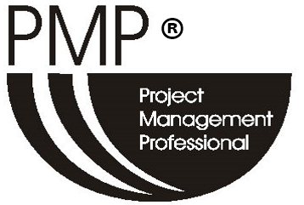

Professionals in Project Management
PMI is a non-for-profit professional membership association for the project management profession. There are PMI Chapters in Canada.
« Project Management Institute »
« Project Management Body of Knowledge » : PMBOK.
PRINCE2 (PRoject IN Controlled Environment) is a certification from the United Kingdom. It is mandatory to receive governmental contracts in many European countries,

Slide 10
Domains of projects in engineering and IT
Projects in engineering and IT include:
Research
Marketing
Development
Manufacturing
Sales
Maintenance

Slide 11
Definition of a projet
« A project is temporary in that it has a defined beginning and end in time, and therefore defined scope and resources. » - PMBOK
Unique
Limited time
Limited resources
Specific Team
Planned and controlled
Specific deliverables
Notes:
A project is temporary in that it has a defined beginning and end in time, and therefore defined scope and resources. And a project is unique in that it is not a routine operation, but a specific set of operations designed to accomplish a singular goal. So a project team often includes people who don’t usually work together – sometimes from different organizations and across multiple geographies.The development of software for an improved business process, the construction of a building or bridge, the relief effort after a natural disaster, the expansion of sales into a new geographic market — all are projects.

Slide 12
Definition of Project Management
«Project management, then, is the application of knowledge, skills, tools, and techniques to project activities to meet the project requirements.» - PMBOK
Manage equilibrium
Scope , Time, Cost, Quality
Requirements
Expectations

Slide 13
Constraints Triangle
SCOPE
(features & quality)
TIME
COSTS
Notes:
From WIKIPEDIA .. As good as any
The Project Management Triangle (called also Triple Constraint or the Iron Triangle) is a model of the constraints of project management. It is a graphic aid where the three attributes show on the corners of the triangle to show opposition. It is useful to help with intentionally choosing project biases, or analyzing the goals of a project.^{[1]} It is used to illustrate that project management success is measured by the project team's ability to manage the project, so that the expected results are produced while managing time and cost.^{[2][3][4]}Like any human undertaking, projects need to be performed and delivered under certain constraints. Traditionally, these constraints have been listed as "scope" (features and quality), "time", and "cost".^{[5]} These are also referred to as the "Project Management Triangle," where each side represents a constraint. One side of the triangle cannot be changed without affecting the others. A further refinement of the constraints separates product "quality" or "performance" from scope, and turns quality into a fourth constraint.
You are given the options of Fast, Good, and Cheap, and told to pick any two. Here Fast refers to the time required to deliver the product, Good is the quality of the final product, and Cheap refers to the total cost of designing and building the product. This triangle reflects the fact that the three properties of a project are interrelated, and it is not possible to optimize all three – one will always suffer. In other words, you have three options:Design something quickly and to a high standard, but then it will not be cheap. Design something quickly and cheaply, but it will not be of high quality. Design something with high quality and cheaply, but it will take a relatively longer time.

Slide 14
PMBOK : 10 Knowledge Areas
Project Integration Management
Project Scope Management
Project Time Management
Project Cost Management
Project Quality Management
Project Human Resource Management
Project Communications Management
Project Risk Management
Project Procurement Management
Project Stakeholder Management
Notes:
Integration Management
Overall coordination of the project to ensure everything “comes together”. Develop Project Charter and Project Management Plan, Direct and Manage Work, Monitor and Control Work, Integrated Change Management, Project Close Out.
Scope Management
Activities to ensure project includes all required work, and only required work. Collect Requirements, Define Scope, Create WBS, Validate Scope (acceptance), Control Scope (change management).
Time Management
Ensure project completes on-time. Define Activities, Sequence Activities, Estimate Resources and Durations, Develop Schedule and Control Schedule.
Cost Management
Complete on-budget. Estimate costs, Determine Budget, Control Costs.
Quality Management
Quality Assurance and Control. Includes continuous process improvement.
Human Resource Management
Get the right people and take care of them. Acquire Team, Develop Team, Manage Team.
Communications Management
Managing project information. Manage Communications, Control Communications.
Risk Management
Increase likely hood and impact of positive events and decrease those for negative events. Identify Risks, Risk Analysis, Risk Response, Control Risks.
Procurement Management
Managing suppliers. Conduct Procurements, Control Procurements.
Stakeholder Management
Requirements gathering and validation., Managing expectations

Slide 15
Project Life Cycle
Definition
Planning
Execution
Closure
Notes:
SHOW THE ESTIMATED TIME FOR EACH PROJECT STAGES OF THE LIFE CYCLE.
NAMES VARRY FOR EVERY BOOK – METHODOLOGY, BUT IT ALWAYS COMES BACK THE THE SAME
Typically takes a phased approach with off-ramps (go-no go decisions) after each phase.

Slide 16
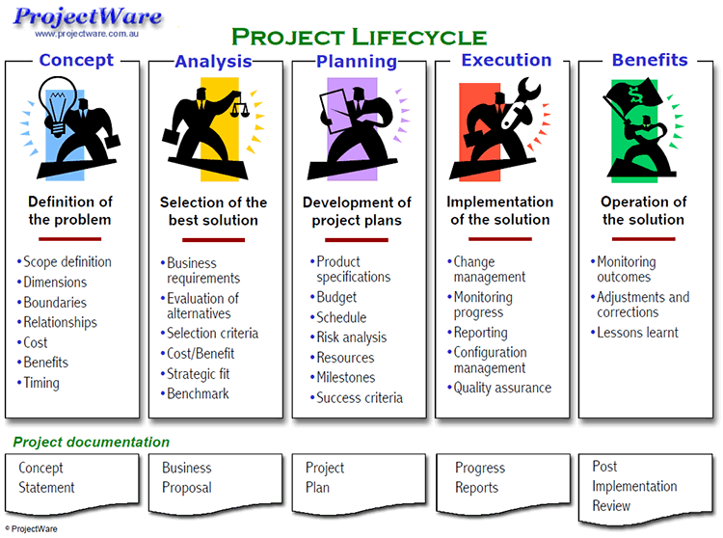
Example Project Lifecycle
Téléchargé du site Project Ware Février 2017
Notes:
GO THROUGH EACH STAGE TO TALK ABOUT THE SUB-PHASES.

Slide 17
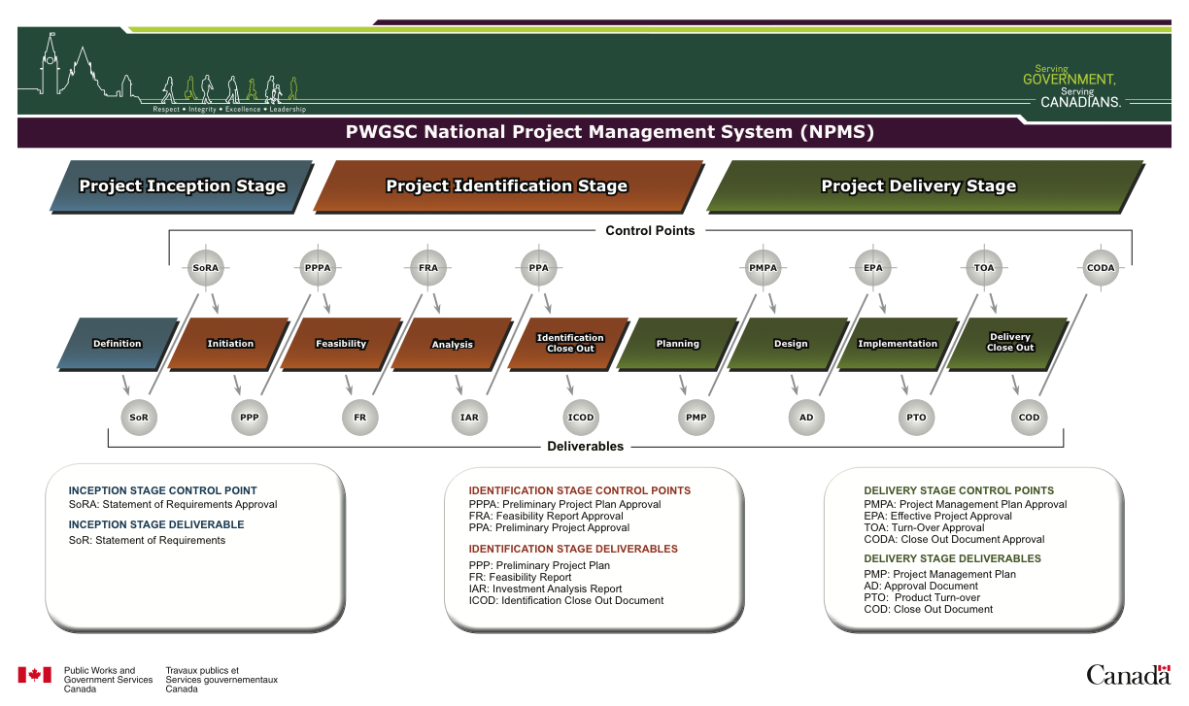
Example – Public Services and Procurement Canada Project Management Framework
Notes:
EXAMPLE – PUBLIC SERVICES PROJECT MANAGEMENT FRAMEWORK.
SHOW HOW THE PRINCIPLES STAY THE SAME.
HERE YOU CAN SEE THAT AT THE END OF EACH PHASE (LITTLE BOXES) THERE IS A DELIVERABLE. IT FORCES PEOPLE TO MAKE DECISIONS AND ADVANCE

Slide 18
THE ACTORS
Sponsor
The Project Team
End Users
Project Manager
Project idea and key parameters
Project execution
Directs the project. Like a conductor: plan, directs, controls
Those who will use the deliverables
Source: NASR, Philippe, La gestion de projet, Ed. Gaëtan Morin, 2006.

Slide 19
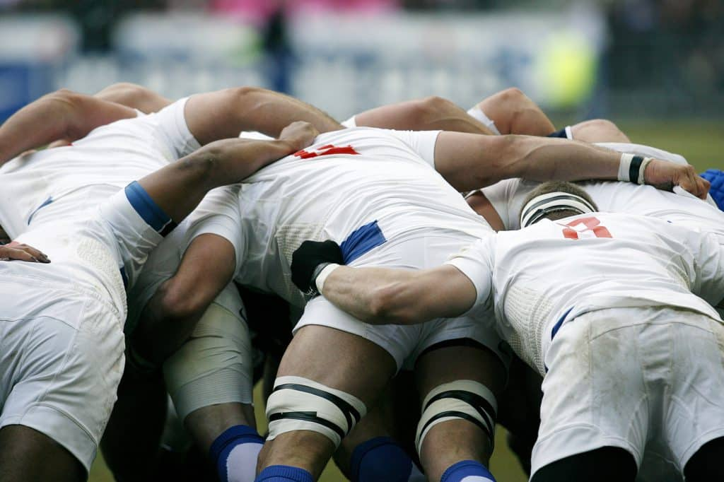
SCRUM
A scrum is a method of restarting play in rugby that involves players packing closely together with their heads down and attempting to gain possession of the ball.
Oxford Dictionnary
INTRO TO SCRUM IN 7 MINUTES
Notes:
Look at the video. Stop after 7 minuts … then it has advertisement for a software.
Parallels with rugby – team work (collaborate), short bursts, defined goal

Slide 20
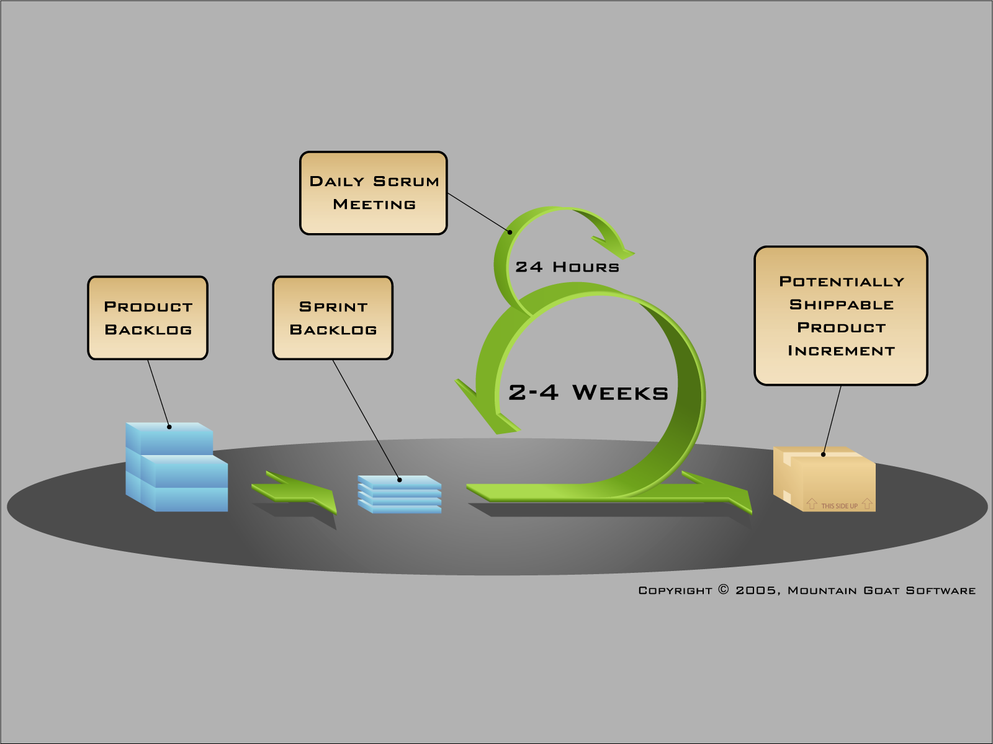
Agile Project Management Methodology
Scrum is just one of the many iterative and incremental agile software development method
Notes:
Scrum is just one of the many iterative and incremental agile software development method. You can find here a very detailed description of the process. In the SCRUM methodology a sprint is the basic unit of development. Each sprint starts with a planning meeting, where the tasks for the sprint are identified and an estimated commitment for the sprint goal is made. A Sprint ends with a review or retrospective meeting where the progress is reviewed and lessons for the next sprint are identified. During each sprint, the team creates finished portions of a product. In the Agile methods each iteration involves a team working through a full software development cycle, including planning, requirements analysis, design, coding, unit testing, and acceptance testing when a working product is demonstrated to stakeholders. So if in a SCRUM sprint you perform all the software development phases (from requirement analysis to acceptance testing), and in my opinion you should, you can say SCRUM sprints correspond to AGILE iterations.
SCRUM originates from the sporting term rugby meaning: melee. Like this technical aspect of the game, the methodology requires its actors to be united in the accomplishment of a project, in achieving a goal. But just like in rugby, a melee is not a unique process. This is a part of the game that is often found to move the team forward.
In the same concept SCRUM uses a procedure that we name iterative (We will speak of sprint to describe the iterations). Each iteration or sprint provides a functional part of product. In summary SCRUM is an agile process that produces the highest business value in the shortest time. In the SCRUM methodology, the business defines priorities. The development team organizes itself to determine the best way to produce the highest priority requirements (referred to as "bottom up"), Finally, at every sprint end, everyone has a decision-making power. The team will decide to deliver the product as is, or continue to improve the product on an additional iteration. If some are still wondering what SCRUM is for, here is a list of features:
Iterative, related to incremental processes
Team-based approach Made to develop products / applications requiring great adaptability
Controlling chaos resulting from conflicts of interest and different needs
Increase communication and maximize cooperation
Protect the team from disruptive external elements A way to increase productivity

Slide 21
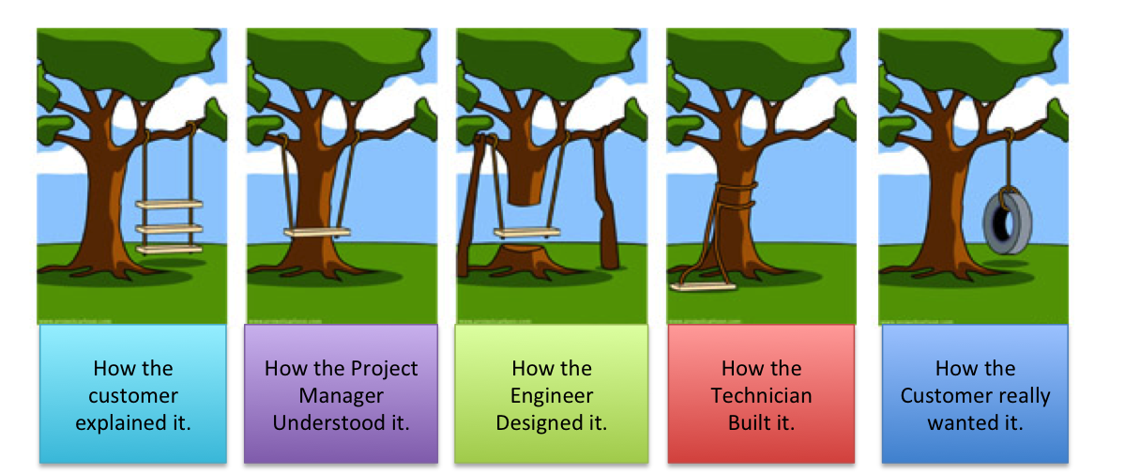
REQUIREMENTS MANAGEMENT and SCOPE MANAGEMENT
Notes:
Clear, concise and unambiguous communications is at the heart of requirements and scope management. This graphic shows that in a team environment it is critical to get everyone on the same page.

Slide 22
If you don’t know where you are going,
you will probably end up somewhere else.
- Lawrence J. Peters

Slide 23
What are Requirements?
Requirement: A condition or capability that is required to be present in a product, service or result to satisfy the “customer”.
What the users need
What the system must do to satisfy user needs
What each component must do
How components/sub-systems will interact
A Requirement can be:
A sentence
A picture or other graphic
Information in a table
User story
Use Case

Slide 24
Types of Requirements
Functional requirements
Capability that the system or software must perform
Non-functional requirements
Conditions that must be met by the system
For example, mass, power consumption, and the “ilities”: Reliability, Maintainability, etc.
Constraints or guidelines
Business rules
Corporate or federal/government regulations

Slide 25
Types of Requirements
User Requirements
What the system or software must do from a users perspective
System Requirements
What the system must do from a builders perspective
Component Requirements
Design level list of things each component must do.
Interface Requirements
Description of the protocol and physical interface between components
Verification and Validation Requirements
Test requirements, test plans/procedures
Notes:
It is important to separate the problem domain from the solution for several reasons, for example:
Need to speak the language of the target audience (users don’t know or care about technical details or complexity).
There is always more than one way to solve a problem. Making a clear separation helps avoid sub-optimal designs.
The system requirements will often contain some margin in order to cope with uncertainties.
Poor Interface requirements often lead to late discovery of incompatibilities.
Verification (does the system meet the system requirements) and Validation (does the system meet the user requirements) requirements is how we prove we built the right thing.

Slide 26
Requirements Management
Requirements management is the process of documenting,, analyzing, tracing, prioritizing and agreeing on requirements and then controlling change and communicating to relevant stakeholders.
It is a continuous process throughout a project.
Aspects of requirements management:
Elicitation/Gathering
Requirement Specification/Writing
Managing Traceability
Managing Attributes
priority, risk, rationale, source, status, etc.
Managing Change and maintaining history/audit trail
Impact analysis, how much will this change cost?
When and why did this change?
Verification and validation
Completeness Analysis, did we test everything?

Slide 27
A Simple Project Information Model
User
requirements
System/Software
requirements
Design
specifications
Satisfies
Satisfies
Constrains
Tests
Tests
Tests
Standards
Acceptance
tests
System/Software
tests
Unit
tests
Notes:
With traceability we can answer questions like:
If user requirement “A” changes, what test, system requirements, documentation, etc. will be impacted? What will that change cost?
If a unit test fails what is the impact on the user requirements? Do we have margin that can accommodate the failure?
Did we test everything?
Are we gold plating? (is there a true need for every system/component requirement)?

Slide 28
SCOPE Management
Project Scope is everything we have to do:
Define & Manage Requirements, Analysis, Design, Test, Deliver
Project Scope Management refers to the set of processes that ensure a project's scope is defined and mapped accurately.
Scope is often defined by a work breakdown structure
Changes to scope should take place only through formal change control procedures.
Requirements Management helps you define and manage Scope
Source: pmi.org (https://www.pmi.org/learning/featured-topics/scope)
See also http://edge.papercutpm.com/scope-management-vs-requirements-management/
Notes:
Requirements define what the solution must do. Scope defines what the project team must do. They are closely related, but different.

Slide 29
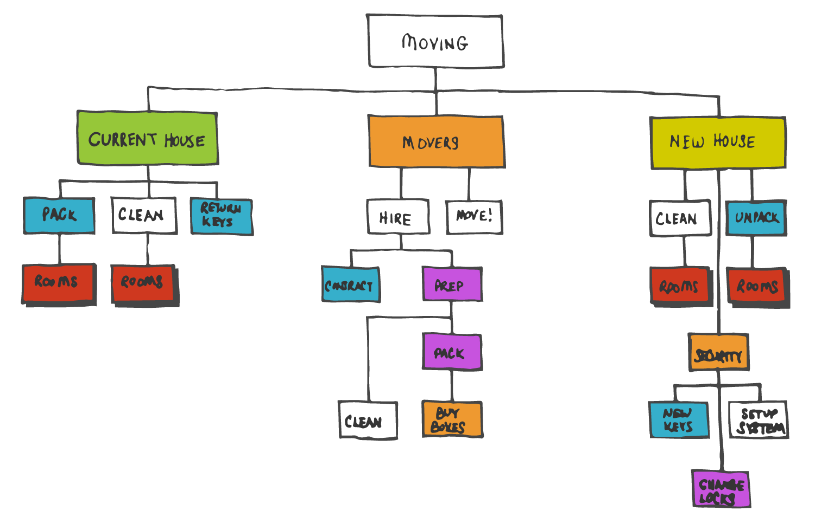
Example - Work Breakdown Structure
Notes:
MAIN DELIVERABLE : WORK BREAKDOWN STRUCTURE
Project Managers and Systems Engineers use hierarchical structures to cope with complexity. You will see many « breakdown structures »: Work Breakdown, Equipment Breakdown, Organizational Breakdown, Requirements Breakdown, etc.

Slide 30

TIME MANAGEMENT

Slide 31
Introduction
Planning : determine all activities & logical order.
What needs to be done?
In which order (dependencies)?
Scheduling: determine start and end date of each activity
When to do it?
Who will do it?

Slide 32
Time Management - Discoveries
1917 – Gantt Chart
1958 – « Program Evaluation and Review Technique » (PERT) developed by the U.S. Navy (missile-defence)
Later modified to produce the Critical Path Method (CPM)

Slide 33
Gantt Chart
Scheduling Aid.
Vertical Axis : activities, ordered by start time.
Horizontal Axis: time
Can be enhanced to show
Assigned Resources
Progress
Dependencies
Critical Path
Baseline Plan
Milestones
Float

Slide 34
P.E.R.T. (Project Evaluation Review Technique)
Nodes: Events/Milestones (ex. Deliverable ready)
Lines: Activities
Task | Preceding task | Duration
A | - | 7d
B | A | 3d
C | - | 10d
D | C,E | 5d
E | - | 4d
F | E | 6d
G | F, E | 3d
Dotted Line: dependency (zero time)

Slide 35
P.E.R.T. Example

Slide 36
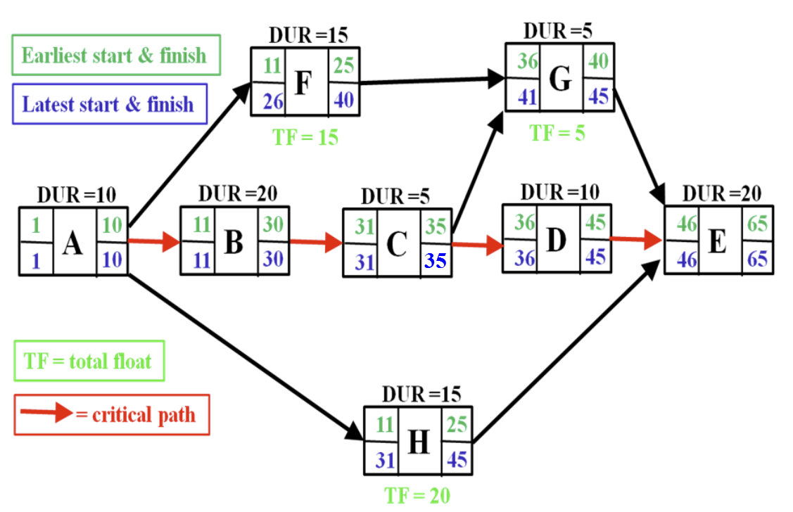
Critical Path Method (CPM)
Activities are shown on Nodes along with:
Activity Duration
Earliest Start/Finish Dates
Add durations from start
Latest Start/Finish Dates
Subtract durations from finish
Activities with LF=EF are critical
Total Float = LF-EF

Slide 37
Critical Path Method (CPM)
The critical path is the path with the longest duration
Any delay on this path will result in a project delay
If we shorten the duration of the critical path the project ends sooner.
More resources (beware of “Mythical Man Month”)
Less Scope
Optimization can switch the critical path to another path.
Activities on non-critical path have “Float” (spare time)
Free Float: ES(n+1)-EF(n) (Activity level spare time)
Total Float: LF(n)-EF(n) or LS(n)-ES(n) (path level spare time)

Slide 38
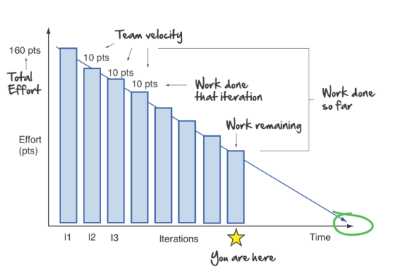
Agile Burndown Chart
The burndown is a chart that shows how quickly you and your team are burning through your customer's user stories. It shows the total effort against the amount of work we deliver each iteration.
Source: Agile in a Nutshell
(Agilenutshell.com)
Notes:
We can see the total effort on the left, our team velocity on the right.
But look what else this simple graphs gives us.
Work done each iteration
Work remaining
Work done so far
When we can expect to be done
All this from one graph!
Burndowns are great because they:
Make the reality of the project clear.
Show the impact of decisions.
Warn you early if things aren't going according to plan.
Get rid of all the wishful thinking around dates.

Slide 39
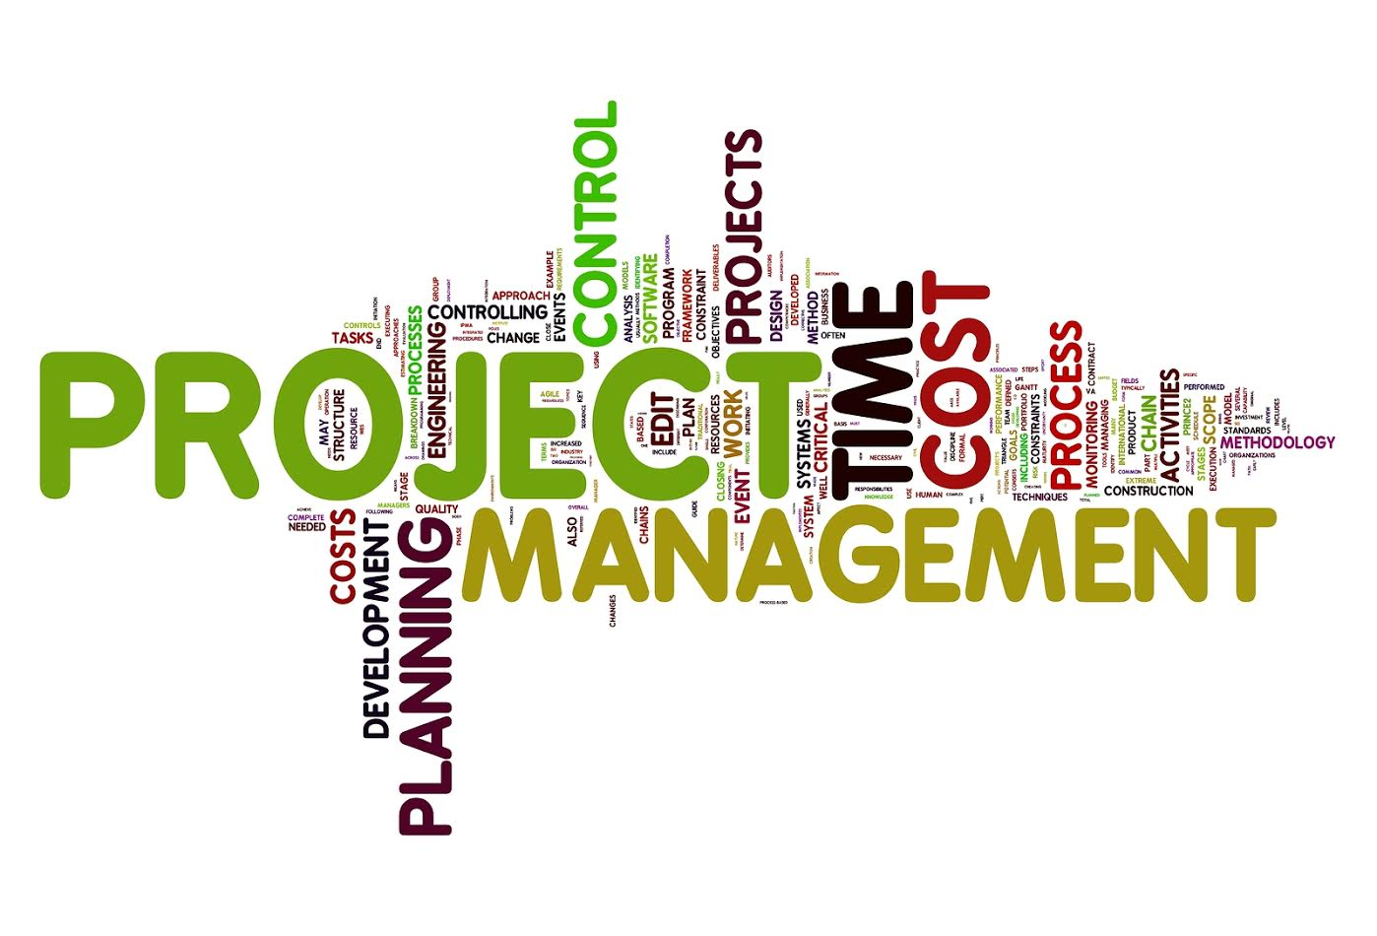
END OF PART 1

Slide 40
COST MANAGEMENT

Slide 41
RISK MANAGEMENT

